Slide 1
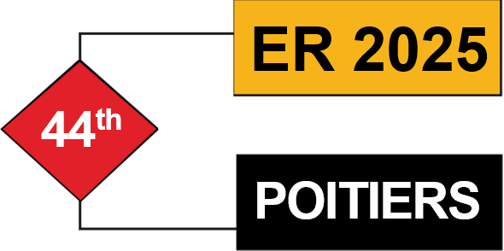
ModelFed: a Federated Protocol for Collaborative Cross-Platform Modeling
Iván Alfonso¹, Jordi Cabot^{1,2}
¹ Luxembourg Institute of Science and Technology
² University of Luxembourg
October 2025

Slide 2
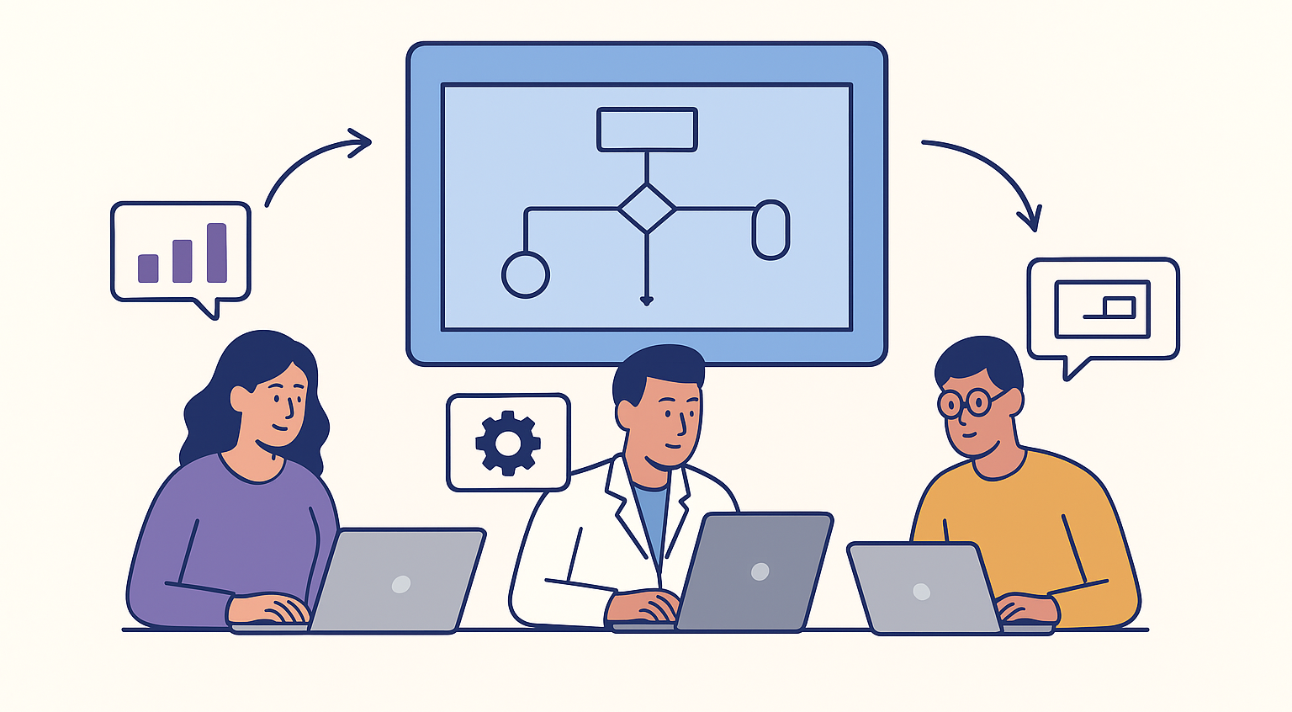
Collaborative modeling
Involves users from different disciplines
Each works with their preferred tools or platforms
Together they build and evolve a shared model
Notes:
Collaborative modeling is about bringing together people from different disciplines — for example, engineers, scientists, domain experts, and other stakeholders to build and evolve a shared model.
In an ideal scenario, every user can contribute to the model design using different platforms with different notations (tabular, textual, graphical, etc.)
Let us begin by considering the concept of collaborative modeling. Collaborative modeling is an approach that brings together users from different disciplines, each contributing their unique expertise to the development process. Importantly, participants are able to work with their preferred tools or platforms, rather than being forced into a one-size-fits-all solution. Through this collaboration, they collectively build and evolve a shared model, ensuring that the final product benefits from a diversity of perspectives and skills.

Slide 3
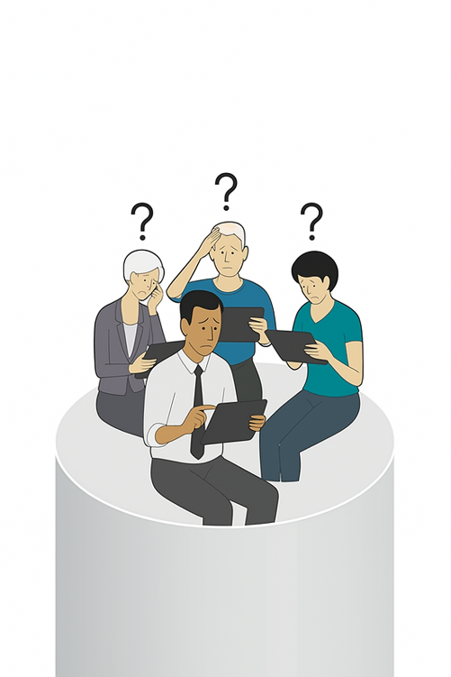
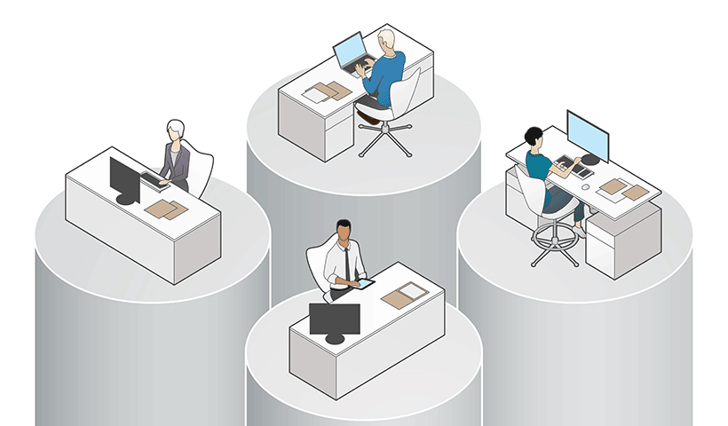
Collaborative modelling Challenges
All users must use the same tool
Notes:
But, in practice, is not like that. And one of the challenge is how to make this collaboration possible across different platforms without forcing everyone into a single tool. (Also represent a lock-in vendor problem)
Introduce single failure points, hamper scalability, and raise privacy and control concerns for participants
Simple arch. Only one API to query and update the model
However, collaborative modeling is not without its challenges. A significant obstacle arises when all users are required to use the same tool. This restriction can hinder participation, as it may not accommodate the varied preferences and workflows of users from different backgrounds. As a result, the collaborative process can become less inclusive and less effective.

Slide 4
Collaborative modelling Challenges
All users must use the same tool
Most solutions rely on a single central server
Central Server
PROS
CONS
Simple architecture
Server orders all updates
Ideal for small or controlled systems
Single point of failure
Limited scalability
Data breach risk
Latency bottleneck
Notes:
But, in practice, is not like that. And one of the challenge is how to make this collaboration possible across different platforms without forcing everyone into a single tool. (Also represent a lock-in vendor problem)
Introduce single failure points, hamper scalability, and raise privacy and control concerns for participants
PROS
Simple architecture → easy to implement
Server orders all updates → no conflicts
Ideal for small or controlled systems
CONS
Single point of failure → if the server crashes, all clients are affected
Limited scalability → performance drops as load increases
Data breach risk → one compromise can expose all information
Network dependency → requires constant connection to the server
Latency bottleneck → all updates go through a single node
Another common challenge is the reliance on a single central server for collaboration. There are some clear advantages to this approach: it offers a simple architecture, the server can efficiently order all updates, and it is well-suited for small or tightly controlled systems. However, there are also notable drawbacks. A central server represents a single point of failure, which can jeopardize the entire system if it goes down. It also limits scalability, introduces risks of data breaches, and can become a latency bottleneck as the number of users grows. These issues highlight the need for more robust and flexible solutions in collaborative modeling environments.

Slide 5
Collaborative modelling Challenges
All users must use the same tool
Most solutions rely on a single central server
Git-like approach
PROS
CONS
No single point of failure
Works offline
Increases resilience
No support real-time collaboration
Complex conflict management
Harder to maintain consistency
Notes:
Pros
No single point of failure → every node has a full copy of the data
Works offline → sync later when connected
Scales well → updates distributed among peers
Enables branching and merging → supports parallel work
Increases resilience → data survives even if one node fails
Cons
Complex conflict management → updates may diverge across replicas
Higher storage requirements → each node stores full history
Sync overhead → merging and reconciliation can be costly
Harder to maintain consistency → may require additional coordination
Steeper learning curve → more complex to understand and implement

Slide 6
Collaborative modelling Challenges
All users must use the same tool
Most solutions rely on a single central server
Our Proposal (Modelverse and ModelFed)
A decentralized ecosystem for cross-platform collaborative modeling
Each platform retains control over its own data and infrastructure
Each user can collaborate while using their preferred tool
Notes:
But, in practice, is not like that. And one of the challenge is how to make this collaboration possible across different platforms without forcing everyone into a single tool. (Also represent a lock-in vendor problem)
Introduce single failure points, hamper scalability, and raise privacy and control concerns for participants
We aim to address these challenges, with Modelverse and ModelFed,
Own data and infrastructure improving privacy, data ownership, and security

Slide 7
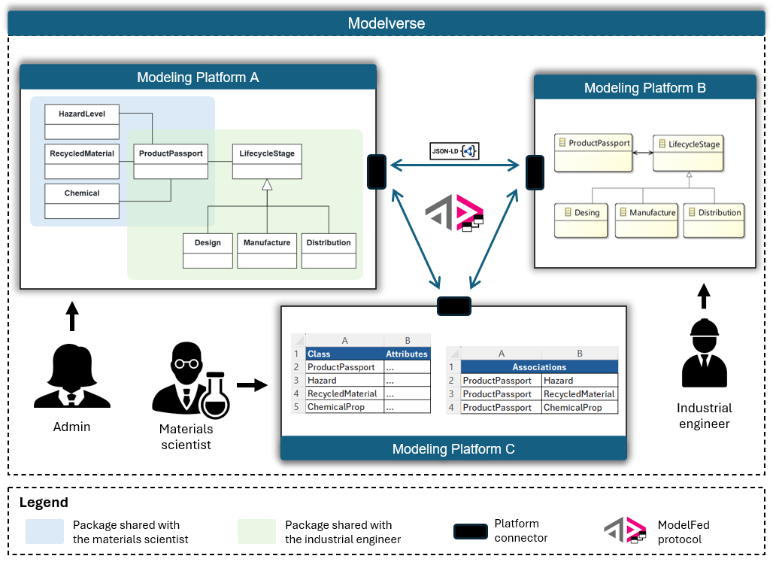
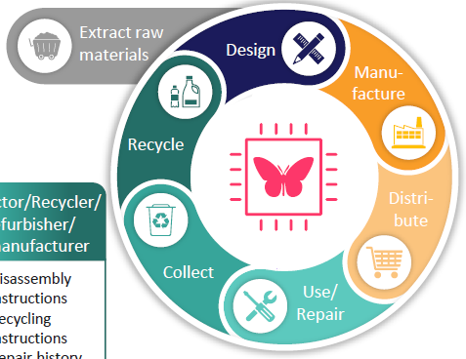


Running example – digital product passport DPP
Material Scientist
Modeling the composition of products, raw material, hazards, recycle…
Industrial Engineer
Modeling of manufacturing processes, carbon footprint, certifications, supply chain…
Admin
Review the overall structure of the DPP data model, ensure consistency…
Notes:
But, in practice, is not like that. And one of the challenge is how to make this collaboration possible across different platforms without forcing everyone into a single tool. (Also represent a lock-in vendor problem)
Introduce single failure points, hamper scalability, and raise privacy and control concerns for participants
We aim to address these challenges, with Modelverse and ModelFed,
Own data and infrastructure improving privacy, data ownership, and security

Slide 8
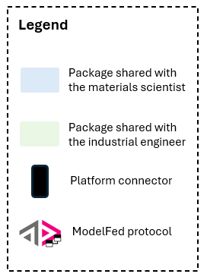
Modelverse: a distributed ecosystem for modeling collaboration
Notes:
scalability, achieved through resource decentralization, which avoids reliance on a single point of failure;
security, since each system can store and protect sensitive information locally, minimizing exposure risks;
and autonomy, as systems maintain their independence

Slide 9
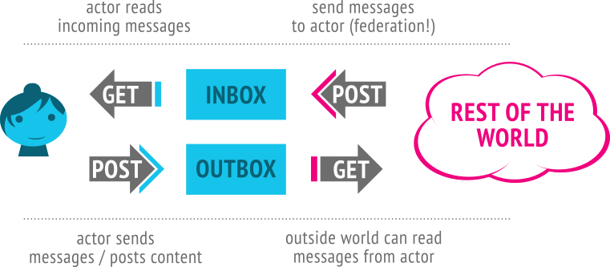
How ModelFed Works
Federated protocol that enables server-to-server interactions between modeling platforms
ModelFed extends the Activity Streams 2.0 model
Each actor must have a user account on a platform server and expose two endpoints:
An outbox, used to send activities to other actors
An inbox, used to receive activities from others
ActivityPub
Notes:
Activity Streams details a model for representing potential and completed activities using the JSON format. It is intended to be used with vocabularies that detail the structure of activities, and define specific types of activities.

Slide 10
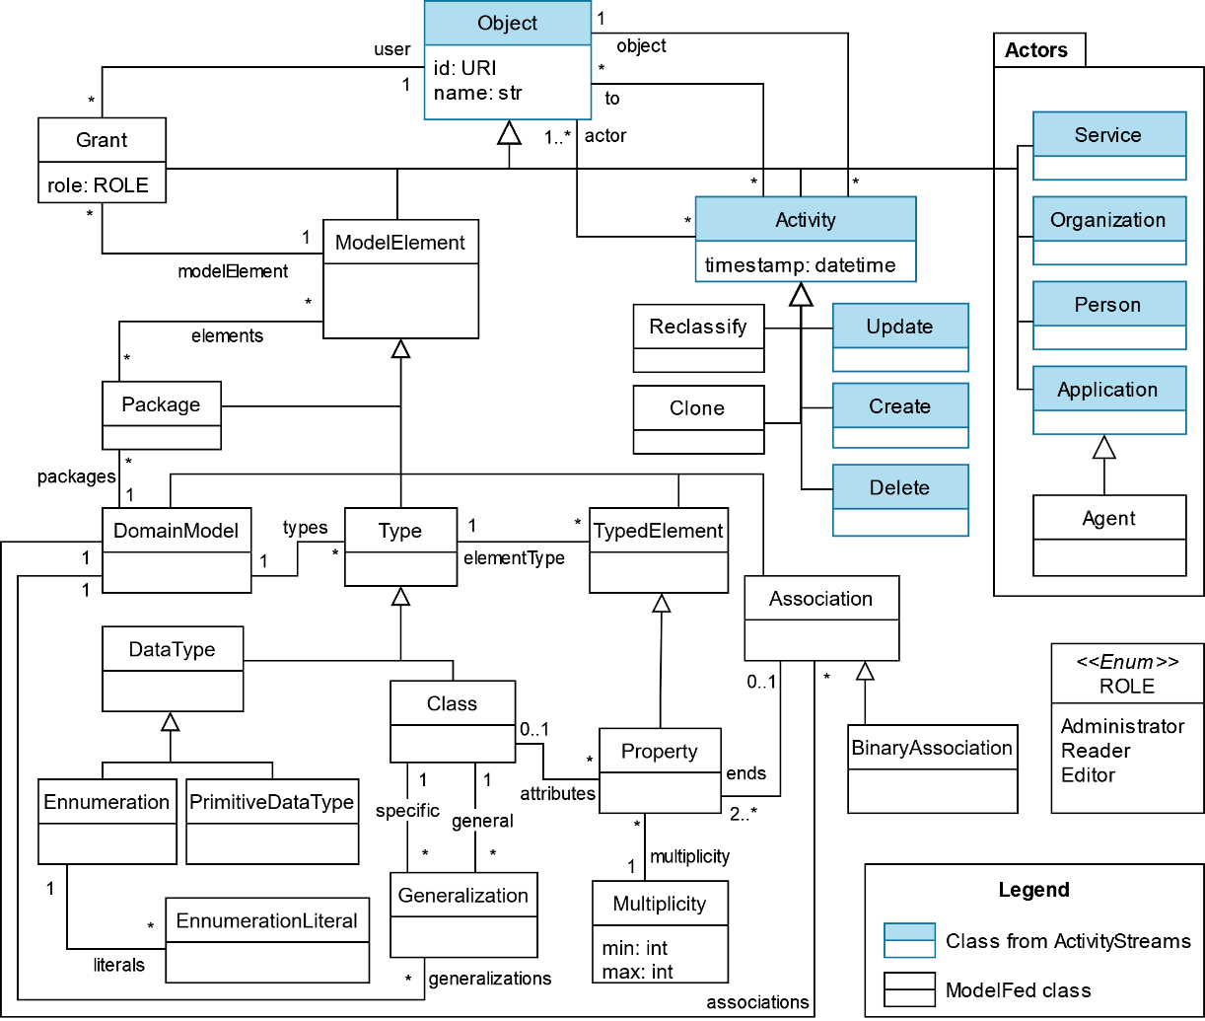
Modelfed vocabulary

Slide 11
Modelfed vocabulary
Model Elements
Elements representing any structural model (classes, attributes, etc.)

Slide 12
Modelfed vocabulary
Model Elements
Elements representing any structural model (classes, attributes, etc.)
Activities
Enable the specification of actions performed on any Object

Slide 13
Modelfed vocabulary
Model Elements
Elements representing any structural model (classes, attributes, etc.)
Activities
Enable the specification of actions performed on any Object
Actors
The people, organizations, services, or applications that can perform activities within a model

Slide 14
Modelfed vocabulary
Model Elements
Elements representing any structural model (classes, attributes, etc.)
Activities
Enable the specification of actions performed on any Object
Actors
The people, organizations, services, or applications that can perform activities within a model.
Grants
Grants control who can do what
Notes:
They define permissions for each actor, specifying which model elements an actor can interact with, and what kind of activities they are allowed to perform.

Slide 15
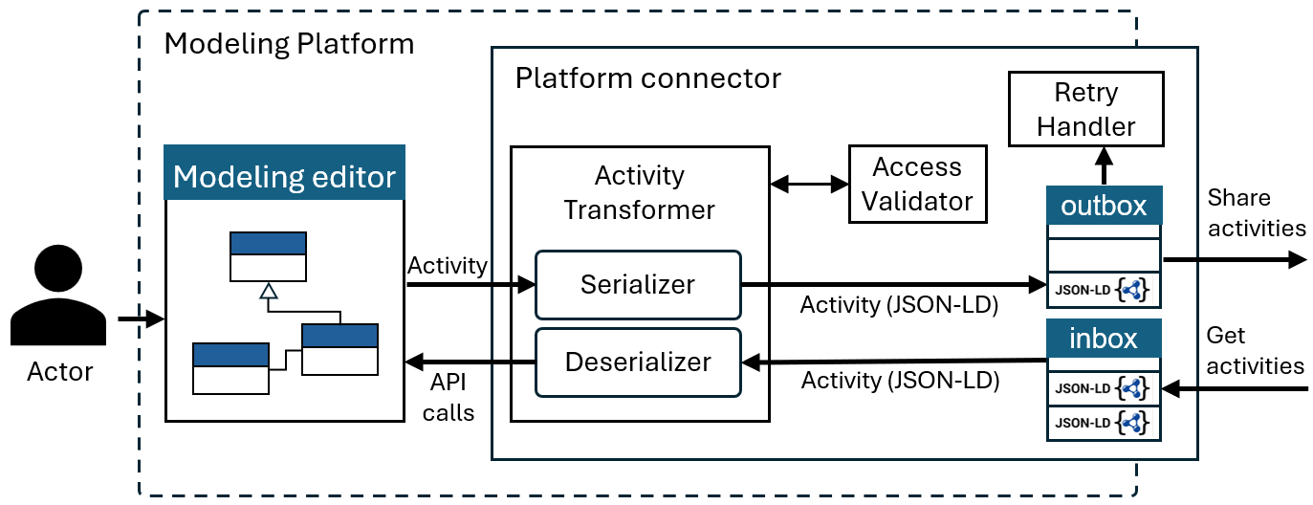
Platform connector
Notes:
The platform connector orchestrates bidirectional synchronization of modeling activities
The inbox and outbox endpoints are RESTful services that handle the exchange of activities between platforms
Access validator to check the Grants, for both incoming and outgoing messages
Activity Transformer which serialize and deserialize the json-ld messages

Slide 16
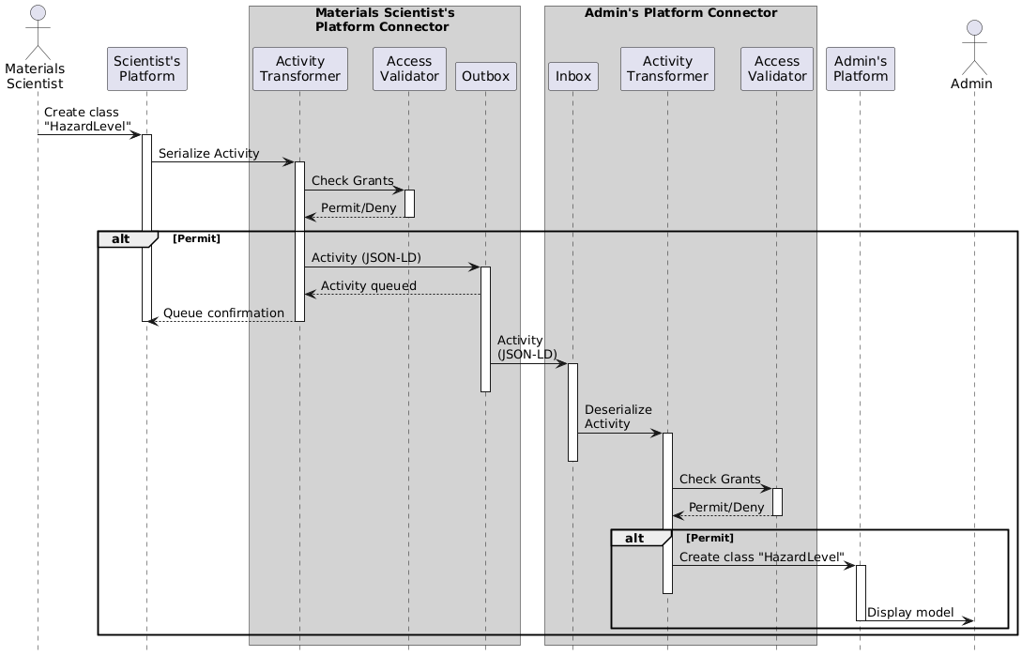
Steps for Creating a Class
Notes:
We’ll get back to this later

Slide 17
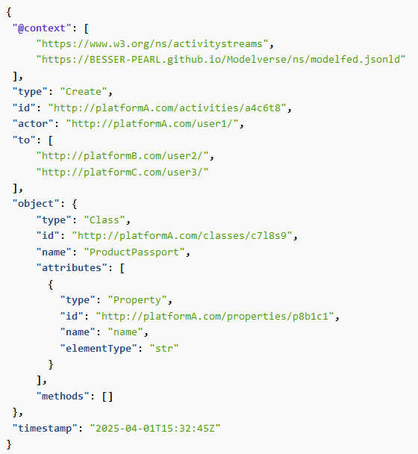
modelFED – json activity example
@context defines the vocabularies used (activitystreams and modelfed)
kind of activity
A unique identifier
The user performing the activity
The recipients: users on Platforms B and C who should receive this activity
JSON-LD activity definition following the ModelFed protocol
The model element being created:
A Class named ProductPassport
It includes the attribute name of type str
Records when the activity occurred

Slide 18


Validation- experiment 1
Modeling platforms: BESSER and PyEcore
Modeling scenario: Digital Product Passport (DPP)
Admin
Industrial Engineer
Material Scientist
PyEcore
Notes:
With this experiment we validated that the federation of activities remained consistent after several attempts

Slide 19
Validation- experiment 1
Modeling platforms: BESSER and PyEcore
Modeling scenario: Digital Product Passport (DPP)
Activities: 50 modeling activities across 3 actors (Admin, Material Scientist, Industrial Engineer)
(admin) Create the DPP domain model
(admin) Create the SupplyChain package
(admin) Create grant with writer role
(ind. engineer) Create the Manufacture class
(ind. engineer) Create the name property for the Manufacture class
(admin) Update property…
…
Notes:
With this experiment we validated that the federation of activities remained consistent after several attempts

Slide 20
Validation- experiment 1
Modeling platforms: BESSER and PyEcore
Modeling scenario: Digital Product Passport (DPP)
Activities: 50 modeling activities across 3 actors (Admin, Material Scientist, Industrial Engineer)
Sequences: 8 distinct activity sequences
(admin) Create the DPP domain model
(admin) Create the SupplyChain package
(admin) Create grant with writer role
(ind. engineer) Create the Manufacture class
(ind. engineer) Create the name property for the Manufacture class
(admin) Update property…
…
1. ...
5. ...
2. ...
3. ...
4. ...
6. ...
Notes:
With this experiment we validated that the federation of activities remained consistent after several attempts

Slide 21
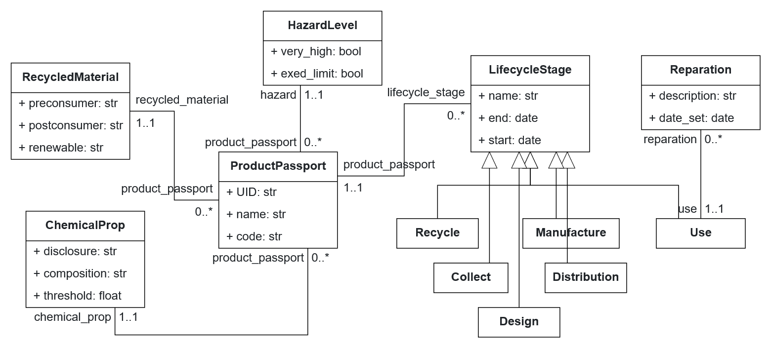
Validation- experiment 1
Modeling platforms: BESSER and PyEcore
Modeling scenario: Digital Product Passport (DPP)
Activities: 50 modeling activities across 3 actors (Admin, Material Scientist, Industrial Engineer)
Sequences: 8 distinct activity sequences
Notes:
With this experiment we validated that the federation of activities remained consistent after several attempts

Slide 22
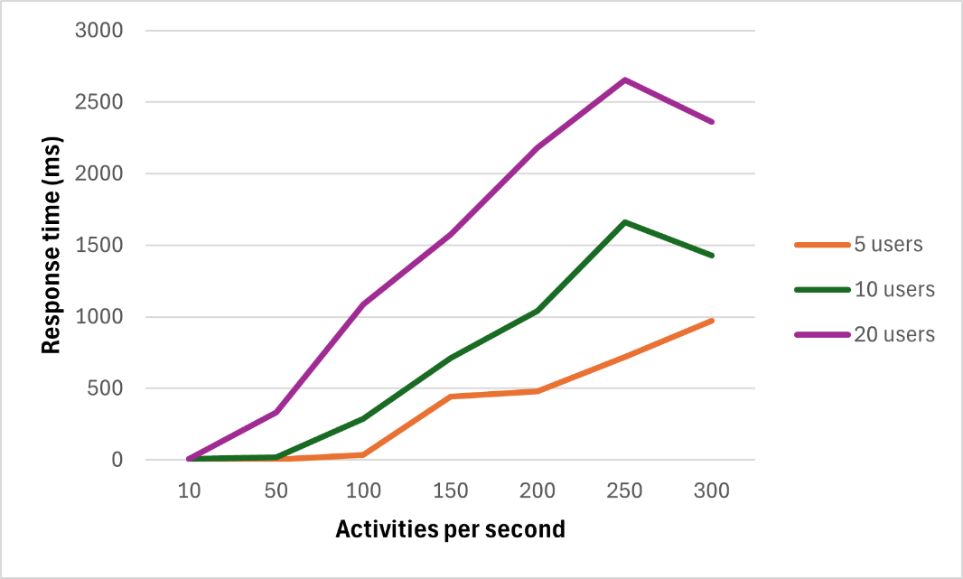
Validation- experiment 2
Modeling platforms: BESSER and PyEcore
Activities: gradually increase the number of modeling activities and users

Slide 23
Validation- experiment 2
Modeling platforms: BESSER and PyEcore
Activities: gradually increase the number of modeling activities and users
Some errors occurred, and some activities were not processed due to server overload
Notes:
the server was unable to handle the volume of request. But executing 50 concurrent activities may not be typical

Slide 24
Summary
ModelFed is a federated and decentralized protocol for cross-platform modeling collaboration
Users can contribute using different notations, while still evolving a shared model
Avoids vendor lock-in and promotes tool interoperability
Add more sophisticated traceability and conflict resolution mechanisms via CRDT
Address delivery failure handling and cryptographic signature verification
AI-assisted connector to automate JSON-LD serialization, validation, and consistency checking
future steps

Slide 25



Thank you
Poitiers, France
https://github.com/BESSER-PEARL/ModelFed https://github.com/BESSER-PEARL/BESSER
ivan.alfonso@list.lu jordi.cabot@list.lu

Slide 26







BESSER Low-code Platform
Low-code approach for smart software
Open-source
5-year FNR PEARL project
B-UML
Modeling
Code
Generation
Deployment
Class diagram
GUIs
Agents
Neural Networks
And more…
Web apps
Databases
BAF agents
Mobile apps
And more…
AWS
GCP
Locally
Notes:
On this slide, we see the architecture of the BESSER low-code platform. BESSER adopts a low-code approach specifically tailored for the development of smart software, enabling rapid prototyping and deployment with minimal manual coding. Importantly, BESSER is open-source, fostering transparency and community collaboration. This platform is the result of a five-year FNR PEARL project, reflecting a significant investment in advancing the capabilities and accessibility of low-code technologies.

Slide 27
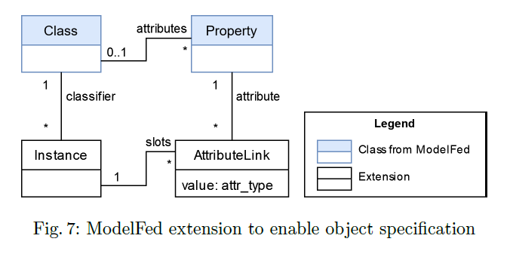
Extension to modelfed for object modeling
Notes:
We’ll get back to this later

Slide 28

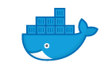



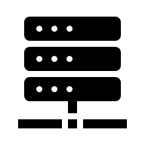




BESSER Low-code Platform
Graphical
language
Grammars
B-UML
MM
Jinja syntax
conforms to
conforms to
instance of
conforms to
Diagram
Code Generators
Generated Code
generates
Image
or
PlantUML
SQLAlchemy
generates
Model
or
generates
REST API
or
Image
Django
REST API
LLM
…
Public cloud
using the B-UML library
…
Other Generators
Hand-code
B-UML Language
Terraform
Modeling stage
Code Generation
Deployment

Slide 29
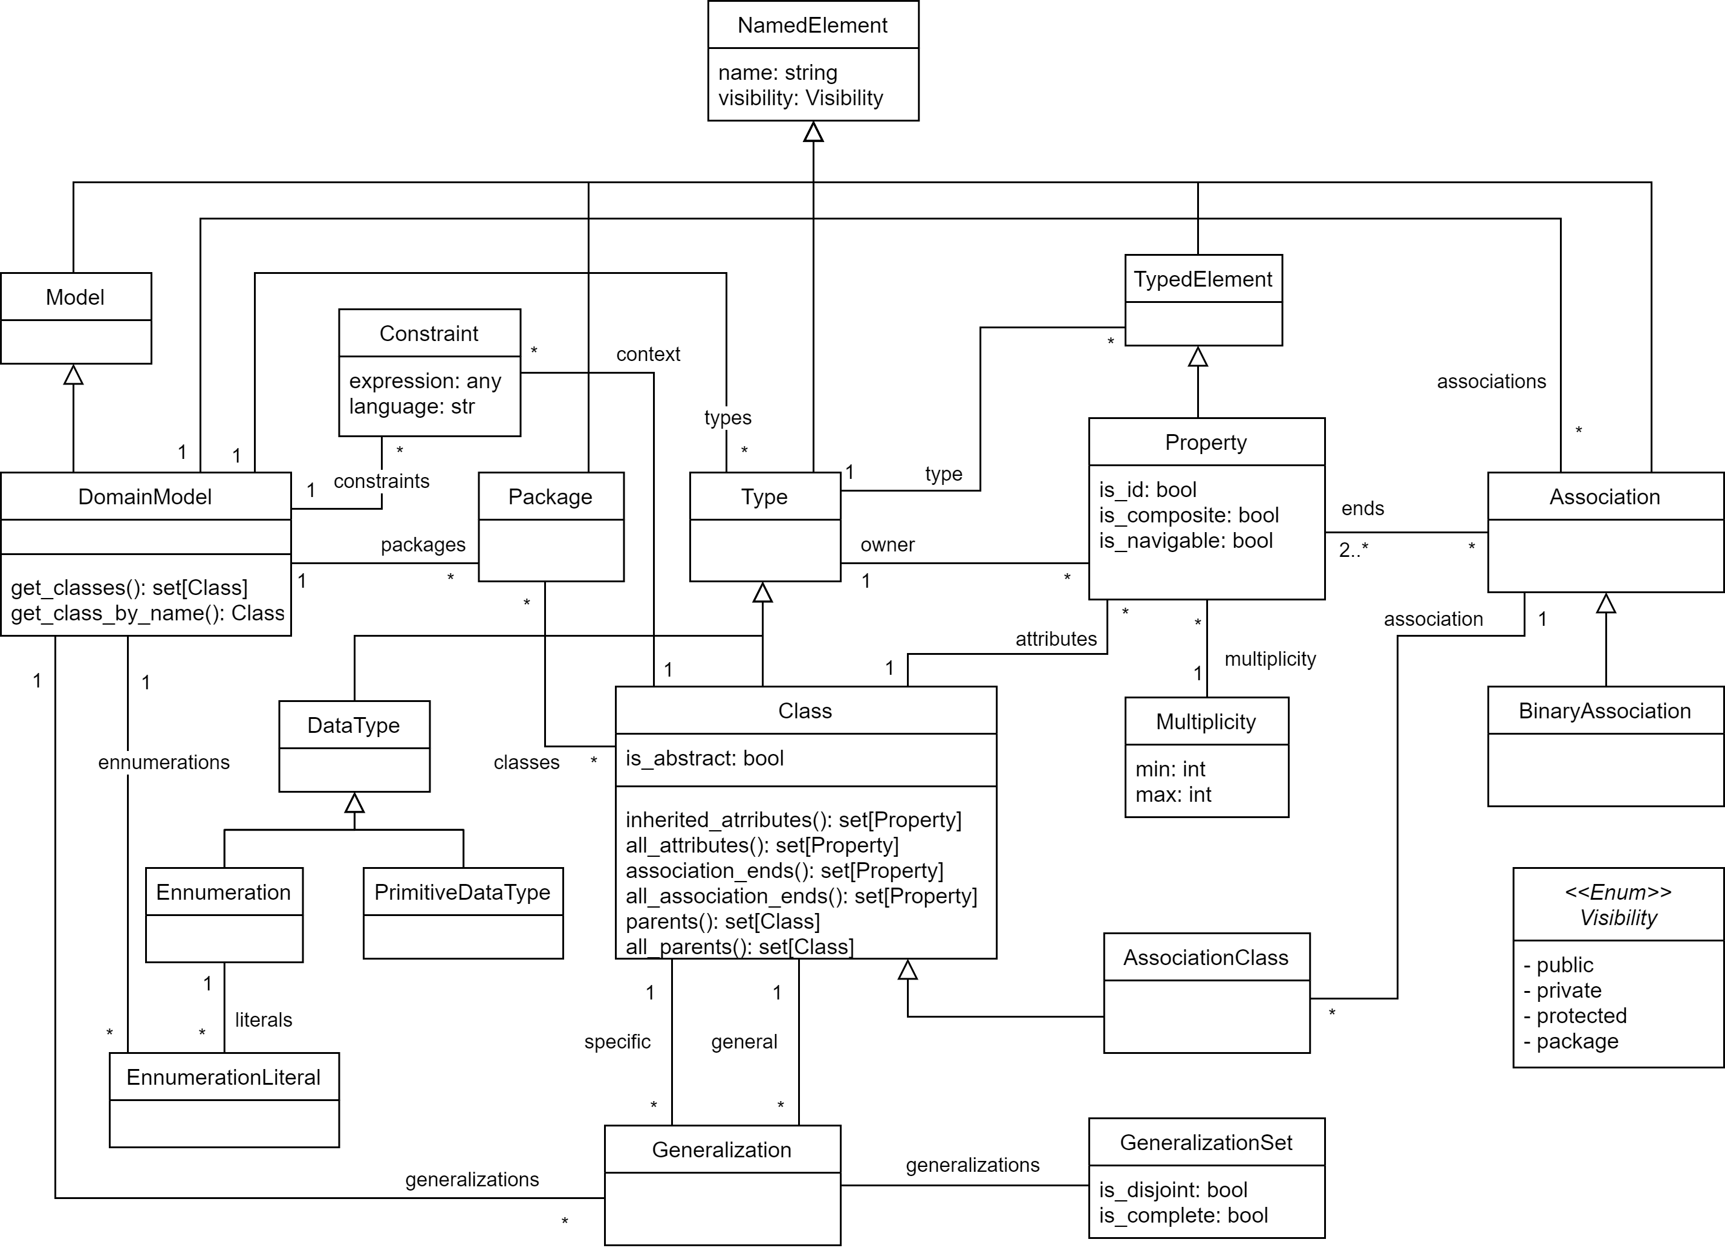
Structural MM

Slide 30
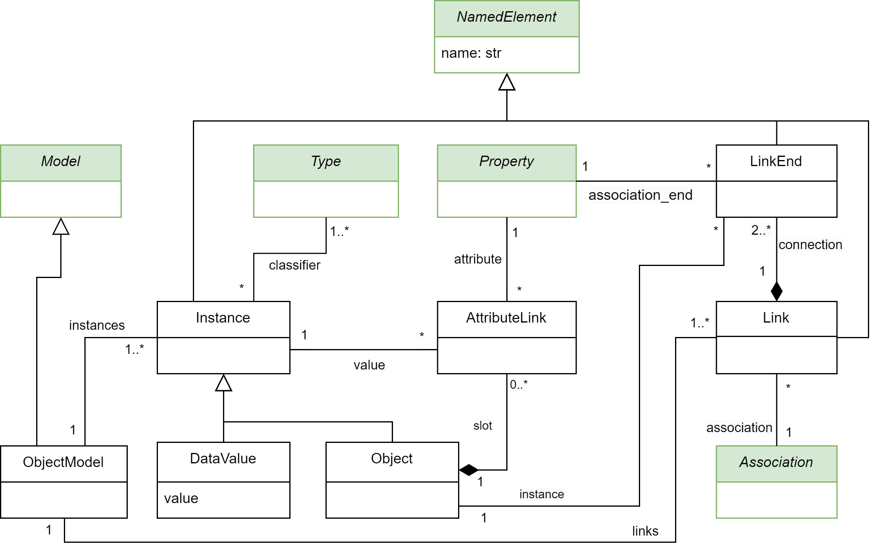
Object MM

